Slide 1
Drone
Basics of Autopilot

Slide 2
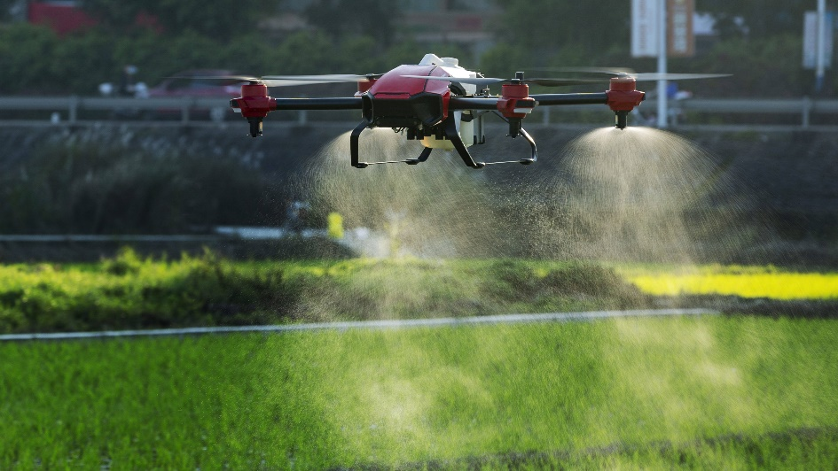
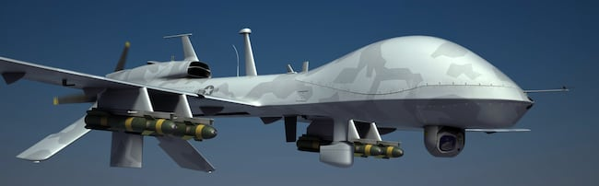
DRONE
Dynamic Remotely Operated Navigation Equipment

Slide 3
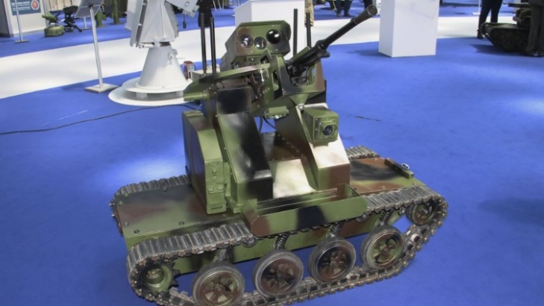
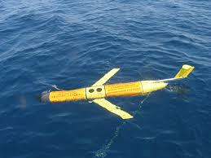
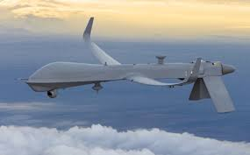
Drone Classification
Based on Application
UAV – Unmanned Aerial Vehicle
UGV - Unmanned Ground Vehicle
UWV - Unmanned Water Vehicle

Slide 4
Drone Classification
Based on weight and Altitude
Size | Weight ( in kg) | Altitude (ft)
Nano | .25 | 1,200
Micro | .25 - 2 | 3,500
Small | 2 - 25 | < 18,000
Medium | 25 – 150 | < 18,000
Large | >150 | > 18,000

Slide 5
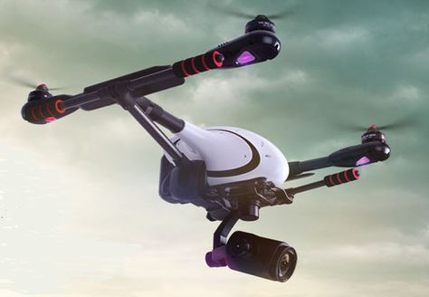
Autopilot
Pilot Assistance System
User Dependent
Is a advanced Flight Controller

Slide 6
Types of GCS
Ardu Pilot – windows and mac
Q Ground control – all platforms
APM Planner- Windows, Mac and Linux
MAVProxy- Linux
UgCS
Dev platform – Dronekit.io

Slide 7
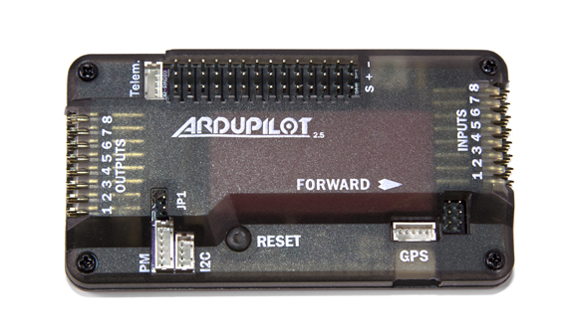
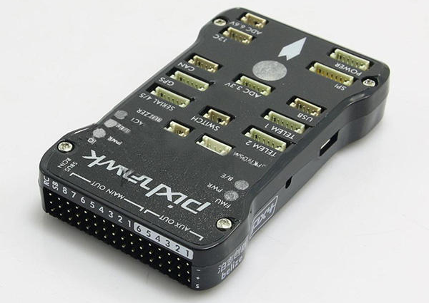
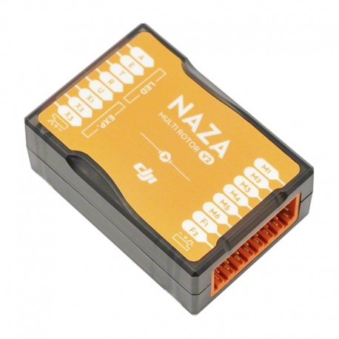
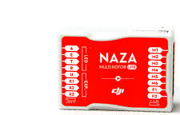
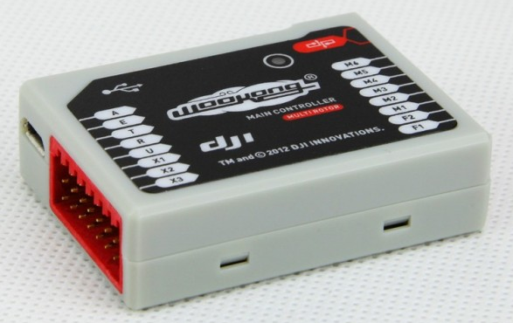
Autopilots available in market
APM – ArduPilot Mega
Pixhawk
Naza MLite
Naza V2
Wookong

Slide 8
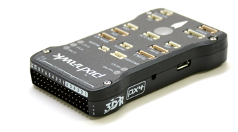
PixHawk
Sensors
3 Axis - Gyroscope
3 Axis - Magnetometer
3 Axis - Accelerometer
Barometer
Microprocessor
168 MHz/256KB RAM / 2MB Flash
32-bit STM32F427 Cortex® M4 core with FPU
32 bit STM32F103 failsafe co-processor

Slide 9
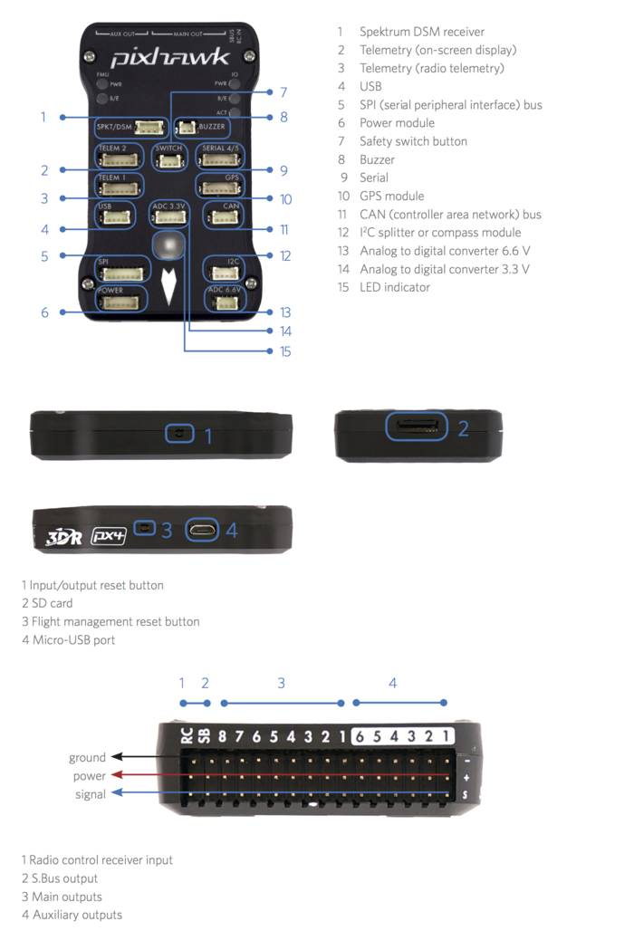
Pixhwak Pinout
Spektrum DSM receiver
Telemetry (on-screen display)
Telemetry (radio telemetry)
USB
SPI (serial peripheral interface) bus
Power Module
Safety switch button
Buzzer
Serial
GPS module
CAN ( Controller area network) bus
I2C Splitter or compass module
Analog to digital converter 6.6V
Analog to digital converter 3.3V
LED indicator

Slide 10
Pixhawk Pinout
Radio Control Receiver Input
S.Bus Output
Main Outputs
Auxiliary Outputs
Input/output Reset Button
SD Card
Flight Management Reset Button
Micro-USB Port

Slide 11
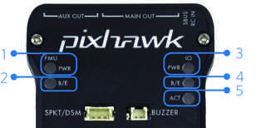
Pixhawk Pinout
Flight management unit (FMU) power
FMU bootloader mode(flashing) or error (solid)
Input/output unit power
I/O bootloader mode(flashing) or error(solid)
Activity (flashing indicates all units responsive)

Slide 12
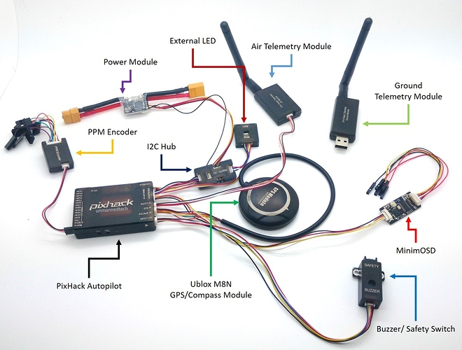
Components of Autopilot System

Slide 13
Components used
Autopilot ( Flight Controller)
GPS
Telemetry (Air and Ground)
Power Module
PPM encoder, Buzzer, Switch, etc. (optional)

Slide 14
GPS – Global Positioning System
Working – Trilateration
HDOP – Horizontal Dilution of Precision
Number of satellites – at least 6 but 10 is good

Slide 15
Flight Modes in Autopilot
Stabilize
Auto
Alt Hold
Position Hold
Loiter
RTL – Return to Launch

Slide 16
Drone regulations in India
UIN-Unique Identification Number Costs Rs.1000.
UAOP(Unmanned Aerial Operator Permit) –Costs Rs.25000 above 200 feet(60m) ,validity 5 years renew (10,000)
UAOP and UIN not required for Micro and Nano(if operating in enclosed area)

Slide 17
Equipment requirements
GNSS (Global Navigation Satellite System)
RTL(Return To Launch)
Anti-Collision Strobe lights
NPNT for app based real-time tracking
Fire resistant UIN (unique identification number) plate
Flight data logging capability
Detect and avoid

Slide 18
Eligibility to get license
18 years
At least Class 10 English
DGCA approved FTO

